Slide 1
Array

Slide 2
What is array
Linear structure of the data elements in the memory.
Can contain only similar data elements in the memory.
Arrays are among the oldest and most important data structures, and are used by almost every program.
Arrays are useful mostly because the element indices can be computed at run time. Among other things, this feature allows a single iterative statement to process arbitrarily many elements of an array.
Declaration of the array:
Data type Array Name[ Size of the array];

Slide 3
Operations can be performed
Traversing
Searching
Insertion
Deletion
Merging
Sorting

Slide 4
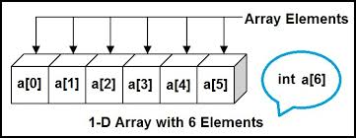
Single/One Dimensional Array
A one-dimensional array (or single dimension array) is a type of linear array.
Its elements involves a single subscript which can either represent a row or column index.

Slide 5
Linear Array:
A linear array is a list of finite number of homogeneous data elements (same data type)
Length of the array is : upper bound-lower bound+1.
UB- Largest index
LB-Smallest index
Representation of Linear Array in memory
LOC(LA[K]=address of the element LA[K] of the array LA.
LOC(LA[K]=Base(LA)+w(K-lower bound).

Slide 6
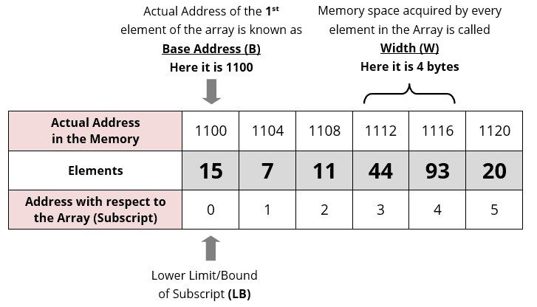

Slide 7
Q1. Data[] is an array that is declared as intData[20]; and contains the following
values:
Data[] = {12, 23, 34, 45, 56, 67, 78, 89, 90, 100};
(a) Calculate the length of the array.
(b) Find the upper_bound and lower_bound.
(c) Show the memory representation of the array.

Slide 8
Traversing an Array
Step 1: [INITIALIZATION] SET k = lower_bound
Step 2: Repeat Steps 3 to 4 while k <= upper_bound
Step 3: Apply Process to A[k] [process means visit element]
Step 4: SET k = k + 1
[END OF LOOP]
Step 5: EXIT

Slide 9
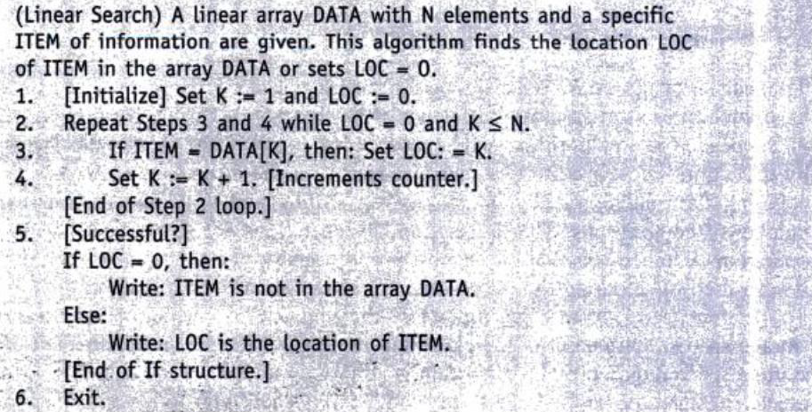

Slide 10
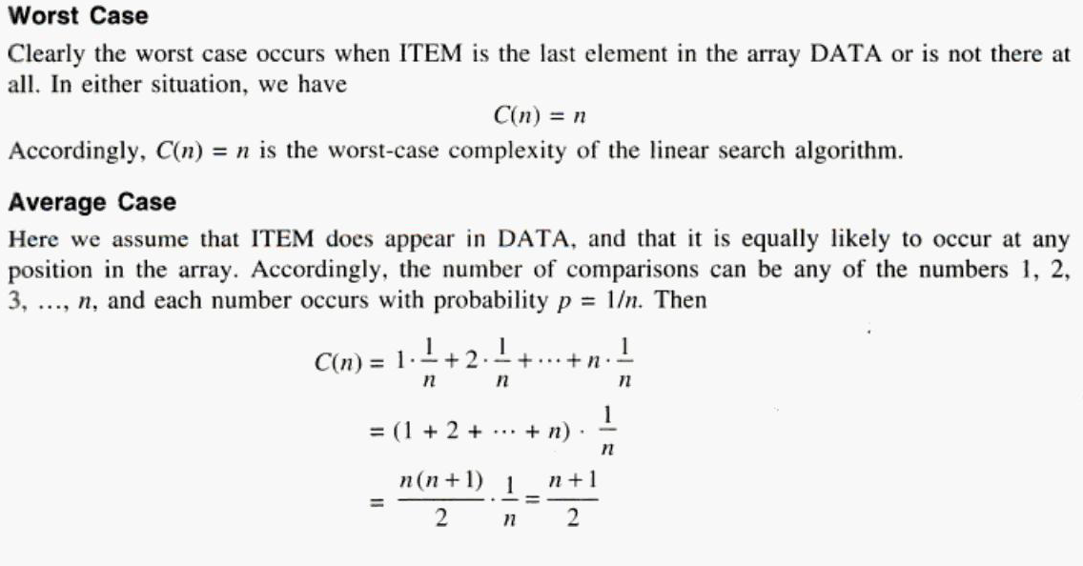

Slide 11
Both insertion and deletion can take place at the following positions:
At start
In between
At end
If an element has to be inserted at the end of an existing array, then the task of insertion is quite simple. We just have to add 1 to the upper_bound and assign the value.
Step 1: Set upper_bound = upper_bound + 1
Step 2: Set A[upper_bound] = VAL
Step 3: EXIT

Slide 12
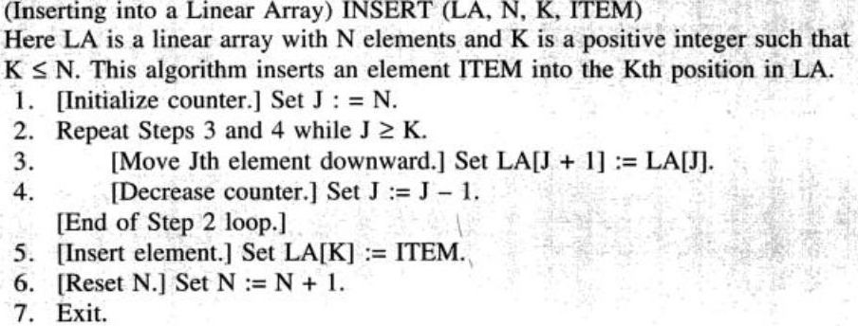

K –position at which we want to insert the element, item-ele to be inserted

Slide 13
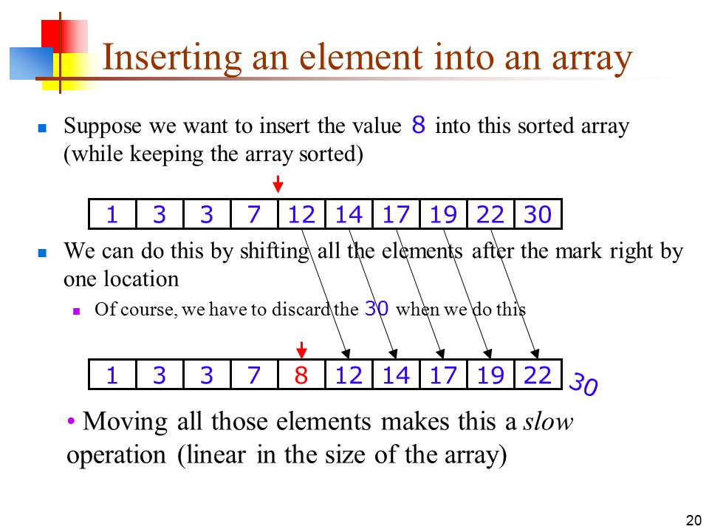

Slide 14
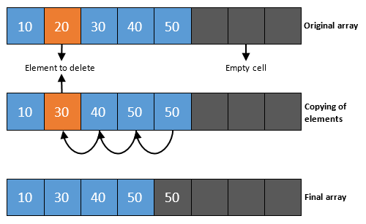
Deletion from end
Step 1: SET upper_bound = upper_bound - 1
Step 2: EXIT

Slide 15
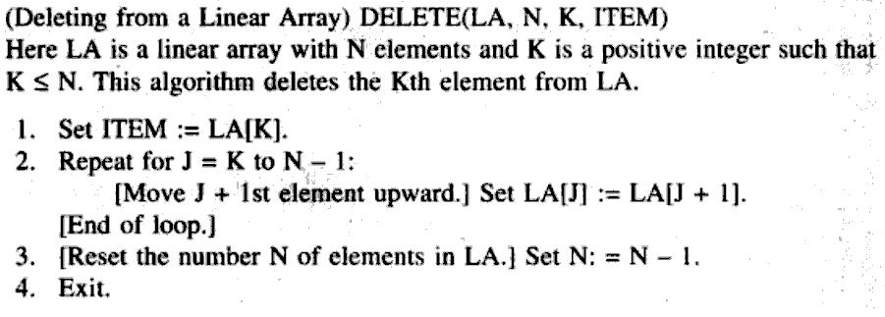
Delete kth element

Slide 16
Advantages and Disadvantages of linear search
Advantages
Easy to understand and simple
Does not require a sorted array
Handy and practical approach when the list to be searched has only a few elements.
Disadvantages:
Slow and time consuming
A major disadvantage of using linear search is that it looks down a list, one item at a time, without jumping any element.

Slide 17
Binary Search
Binary search is a searching algorithm that works efficiently with a sorted list.
This search algorithm works on the principle of divide and conquer. For this algorithm to work properly, the data collection should be in the sorted form.
Binary search can be used only with list of element which are already arranged in a order. The binary search can not be used for list of element which are in random order.
This search process starts comparing of the search element with the middle element in the list. If both are matched, then the result is "element found".

Slide 18
Otherwise, we check whether the search element is smaller or larger than the middle element in the list. If the search element is smaller, then we repeat the same process for left sublist of the middle element. If the search element is larger, then we repeat the same process for right sublist of the middle element. We repeat this process until we find the search element in the list or until we left with a sublist of only one element. And if that element also doesn't match with the search element, then the result is "Element not found in the list".

Slide 19

mid = low + high / 2
Here it is, 0 + 9 / 2 = 4 (integer value of 4.5). So, 4 is the mid of the array.

Slide 20
Step 1: [INITIALIZE] SET BEG = lower_bound , END = upper_bound, MID= INT ((BEG+END)/2).
Step 2: Repeat Steps 3 and 4 while BEG <=END
Step 3: SET MID = (BEG + END)/2
Step 4: IF A[MID] = VAL PRINT VAL Go to Step 7
ELSE IF A[MID] > VAL
SET END = MID - 1
ELSE
SET BEG = MID + 1
[END OF IF]

Slide 21
Step 5: set MID= INT((BEG + END)/2)
[END OF LOOP] loop is closing here.
Step 6: IF DATA[MID]= VAL
SET LOC=MID
ELSE
SET LOC=NULL
[END OF IF]
Step 7: EXIT

Slide 22
Complexity of Binary Search Algorithm
best case is when the key is equal to the first element compared from the list, in which case only one comparison is needed.
The worst case occurs when the key is present in the list but at such a position/ index that it requires more comparisons to find it.
Another possible worst case is when the value is not present in the list.

Slide 23
Advantages
Binary search one must have random access to the data but linear search only requires sequential access.
Binary search requires the input data to be sorted.
Binary search requires an ordering comparison where as linear search only requires equality comparisons.

Slide 24
Two Dimensional Array
An array of arrays is known as 2D array.
The two dimensional (2D) array is also known as matrix. A matrix can be represented as a table of rows and columns.
The data associated with certain systems (a digital image, a board game, etc.) lives in two dimensions.

Slide 25
How do we declare a 2D array?
Similar to the 1D array, we must specify the data type, the name, and the size of the array. But the size of the array is described as the number of rows and number of columns.
E.G:
Int a[rows][cols];

Slide 26
Access data in a 2D array:
Like 1D arrays, we can access individual cells in a 2D array by using subscripting expressions giving the indexes, only now we have two indexes for a cell: its row index and its column index. The expressions look like:
A[i][j]=0;
We can initialize all elements of an array to 0 like:
for(i = 0; i < MAX_ROWS; i++)
for(j = 0; j < MAX_COLS; j++)
a[i][j] = 0;

Slide 27
How to store user input data into 2D array
We can calculate how many elements a two dimensional array can have by using this formula:
The array arr[n1][n2] can have n1*n2 elements.

Slide 28
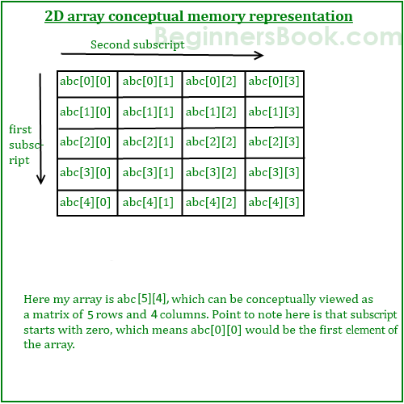

Slide 29
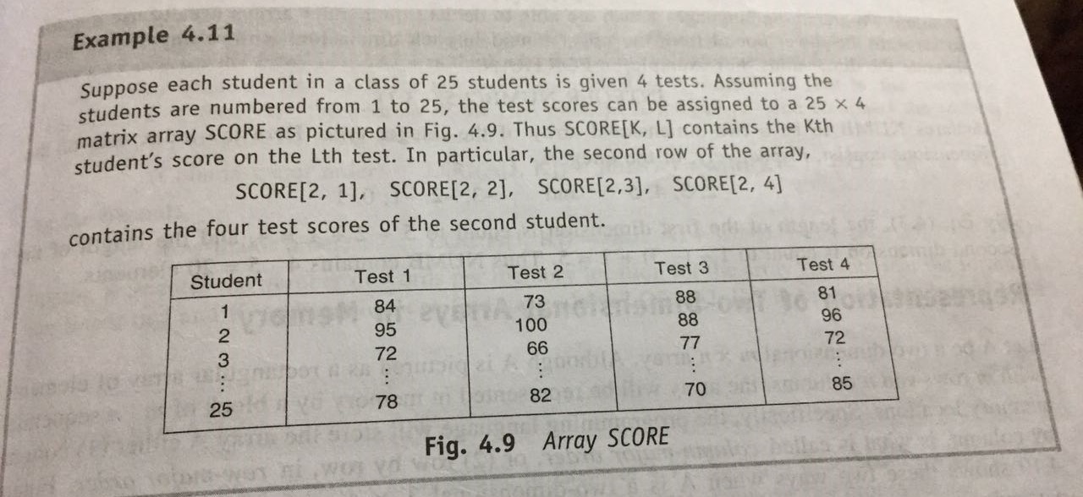

Slide 30
Representation of 2D Array in memory
Array= Arr[10:15, -2:2];
No of rows are: UB-LB+1 (15-10+1)=6
No of columns are: UB-LB+1 (2-(-2)+1)=5
2 different techniques of representation:
Row Major and Column Major.
Row Major:
Elements are stored row wise.
Rows are listed on the basis of columns.

Slide 31
How to find address of element using row major order:
Formula: Address of element= B+ W(n(i-l1) + (j-l2))
B= Base address
W= size of element
N=number of columns.
i= desired row of the element.
j= desired column of the element
L1= lower bound of row.
L2=lower bound of column

Slide 32
E.G arr[4:7;-1:3], 2 bytes of storage of each element, Add of Arr[6][2], base address is 100

